Slide 1


LBGP: Learning Based Goal Planning for Autonomous Following in Front
Payam Nikdel, Richard Vaughan, Mo Chen

Slide 2

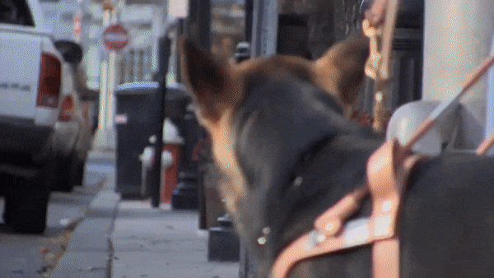
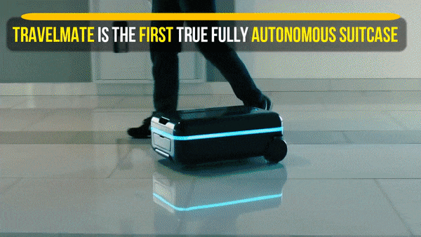
Challenges
Following in front can be challenging
Predict the future trajectory of the person
Find a feasible and safe way to navigate ahead
Guide dog​
Autonomous suitcase (Travelmate) ​
Notes:
Following in front can be challenging as we need to first predict the human trajectory. Then find a feasible way to navigate the robot ahead of human while maintaining a safe distance.

Slide 3

Contributions
Demonstrate zero-shot sim2real transfer
Combine a robotics trajectory planner with deep RL to improve
Safety
Generalizability
Use curriculum learning to
Reduce the training time
Improving the final return
Achieve the state-of-the-art performance in front following task
Evaluation done both in the simulation and real-world
Notes:
The contributions of our paper are the following:
We demonstrate that the policy trained using our method can directly transfer to the real world without any retraining.
We improve the safety and generalizability of our system by combining a robotics trajectory planner and deep RL
Using curriculum learning we reduce the training time while improving the final return
Lastly, by evaluating our system in the simulation using a Clearpath Jackal and in the real world using a Turtlebot 2 robots, we show that our system can be more reliable and efficient for front-following in compare to the current state-of the art or an end-to-end method.

Slide 4
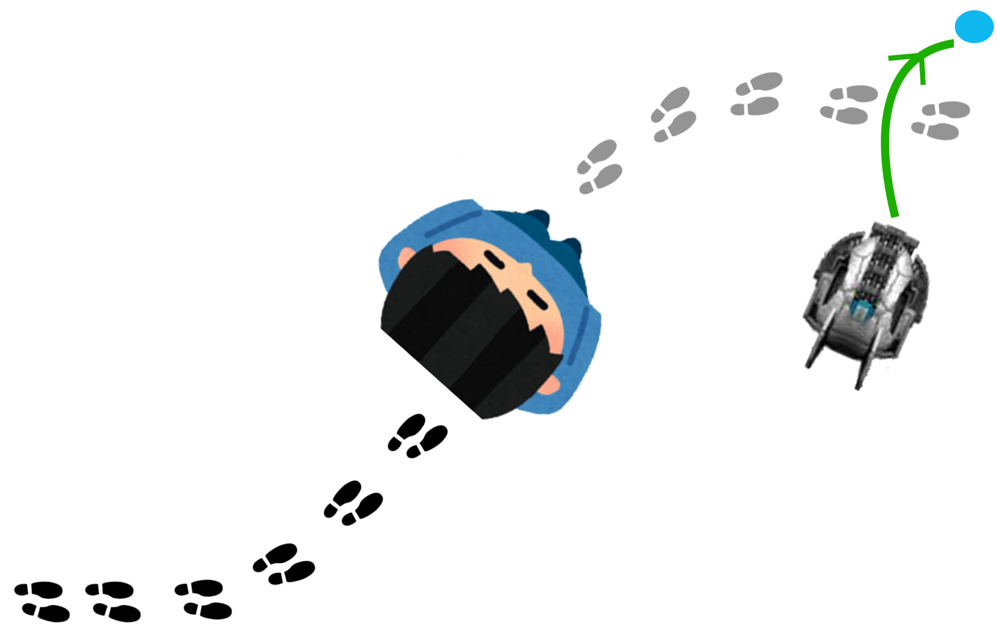
Method
Hybrid Approach (LGBP):
Deep RL
Using our implementation D4PG^{[1]}
Output a short navigational goal
Employ curriculum learning to:
Reduce the training time
Higher return
Classical Trajectory Planners
TEB^{[2]} planner navigates the robot toward the goal
Goal
State
LGBP
TEB Planner
[1] G. Barth-Maron, M. W. Hoffman, D. Budden, W. Dabney, D. Horgan,A. Muldal, N. Heess, and T. Lillicrap, “Distributed distributional de-terministic policy gradients,”arXiv preprint arXiv:1804.08617, 2018
[2] http://wiki.ros.org/teb_local_planner
Notes:
Our learn based goal planner approach uses the combination of deep RL and classical trajectory planners. Our policy employs an implementation of D4PG to output a short navigation goal.
We combine it with a curriculum to reduce training time while achieving a higher return.
Then a Classical trajectory planners navigates the robot toward the goal

Slide 5
Baselines
Goal
The latest Hand Crafted Following Ahead (HC)^{[1]}
Exploits EKF to predict future position of human
Navigate to this position using a trajectory planner
An End-to-End learning Following Ahead (E2E) :
The same D4PG implementation (with curriculum leaning)
Policy output linear and angular velocities
State
EKF
TEB Planner
State
E2E
[1] P. Nikdel, R. Shrestha, and R. Vaughan, “The hands-free push-cart:Autonomous following in front by predicting user trajectory aroundobstacles,”2018 IEEE International Conference on Robotics andAutomation (ICRA), pp. 1–7, 2018
Notes:
We compare our method in both simulation and real world using two baselines
The first one is the latest hand crafted following ahead paper. They exploits EKF to predict the position of the user. Then using a trajectory planner robot navigates to the predicted position.
The second baseline is an End-to-End Learning approach, we use the same D4PG implementation with our curriculum leaning, but instead of a navigational goal, the policy directly outputs the robot’s linear and angular velocities
In what follows first we will go over the simulation experiments. And then show the real-world results

Slide 6
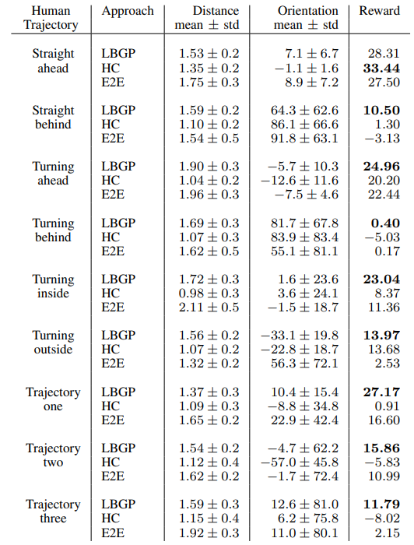
Simulation Experiments
Straight Experiment
Turing Experiment
Simulated Trajectories Experiment
Notes:
We conduct three experiments with different human trajectories. In each experiment, we report the mean person-robot angle , the mean robot-user distance and the episode accumulated reward
The results for all the simulation experiments using our system LBGP versus baseleines are shown on the table. For all challenging trajectories our model achieves the highest return.
------- for all the experiments except straight ahead experiment. HC method can achieve a better results in this case as the incorporated EKF relies on linearity of human motion and it can optimally follow the straight line while we consider noise in our system so the robot may slightly deviate to the sides.

Slide 7
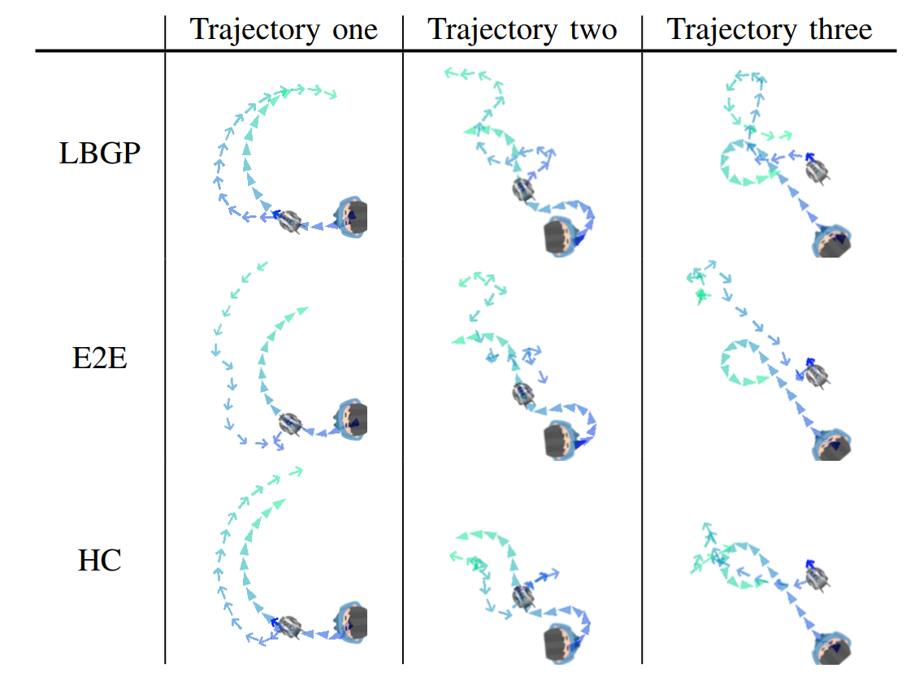
Notes:
This image shows the trajectories of human and robot during the third simulation experiment using our systems versus two baselines.

Slide 8
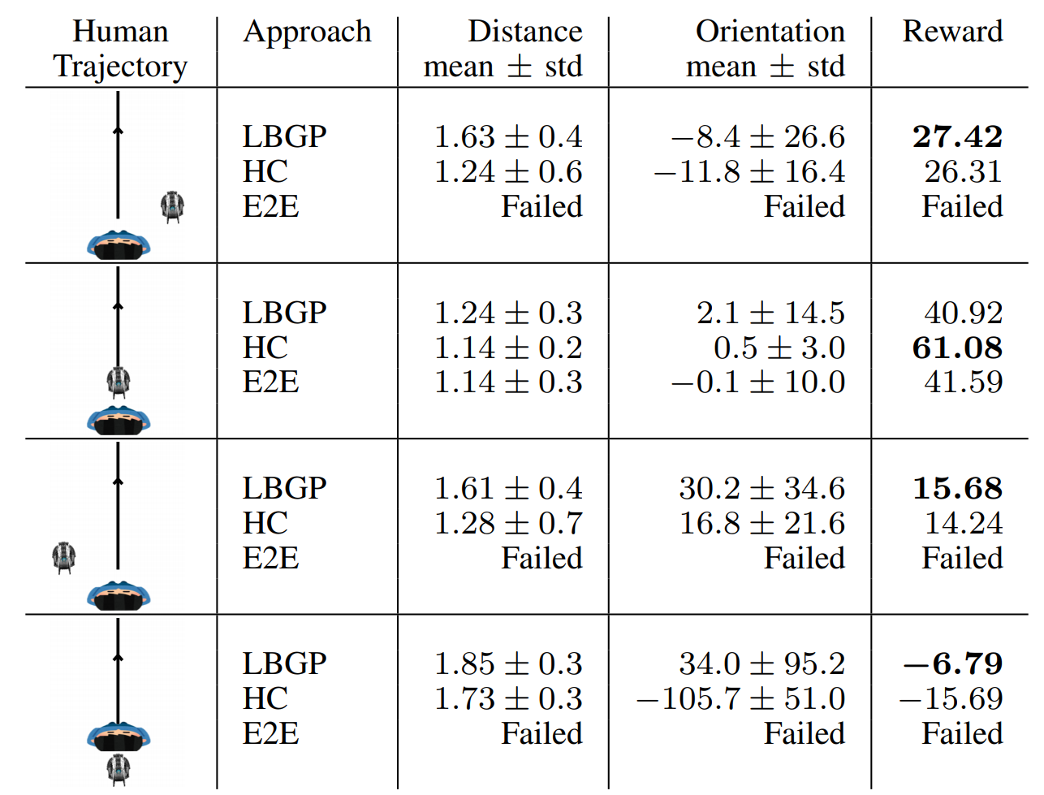
Real World Experiment Straight Trajectory:
Notes:
In the following we will go over the results of real world experiments first we will show the results of each experiment in a table comparing our system versus two base lines and then show the video of each experiment. This table shows the performance of our method in compare to baselines for the straight experiment using 4 initial settings. The end-to-end method failed most of the experiment by colliding with the user so we are not including its videos.

Slide 9
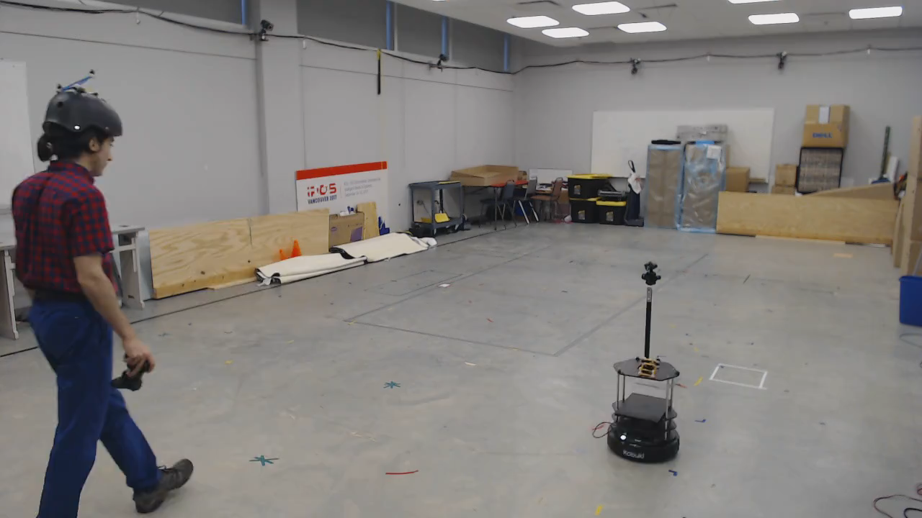
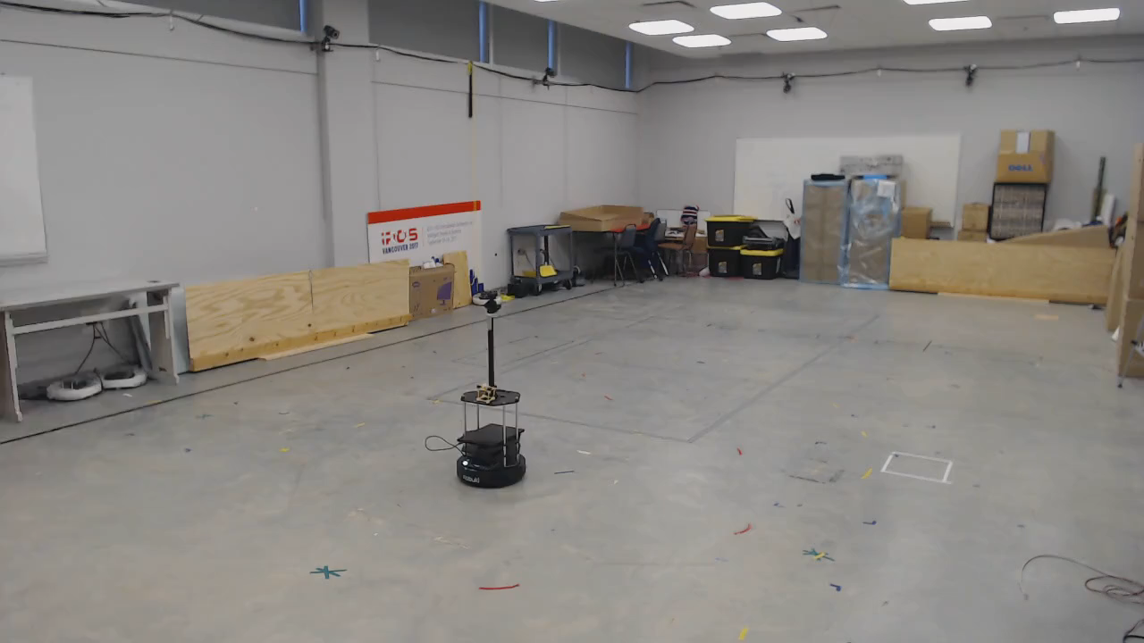
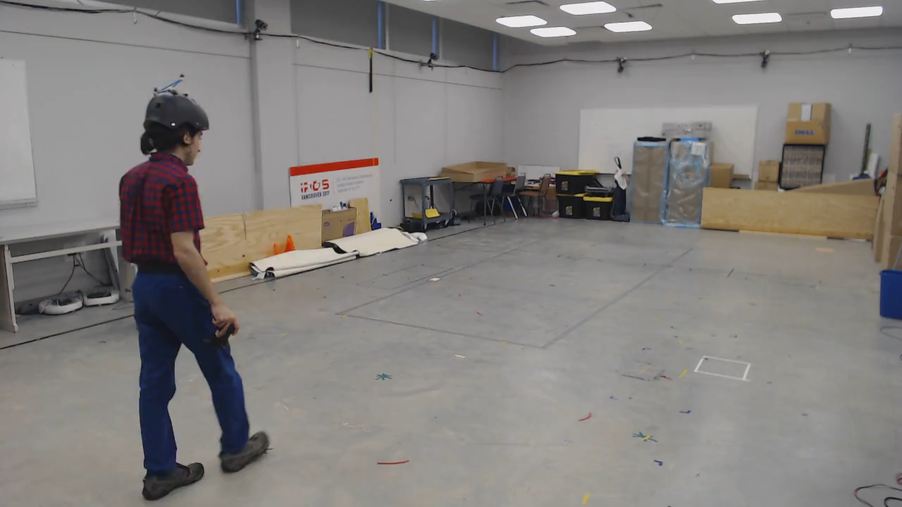
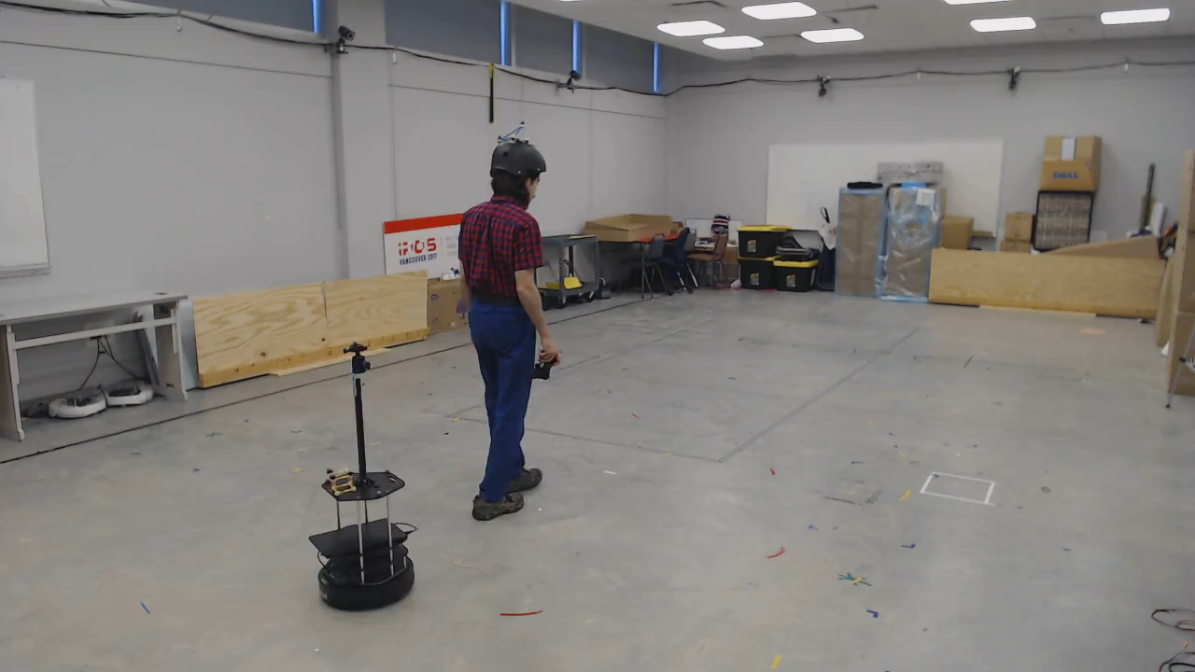
Our method (LBGP)
Ahead-right
Ahead
Ahead-left
Behind

Slide 10
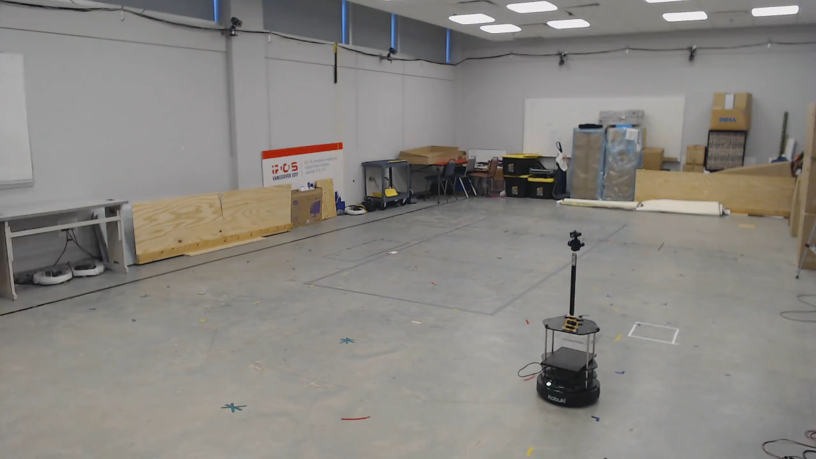
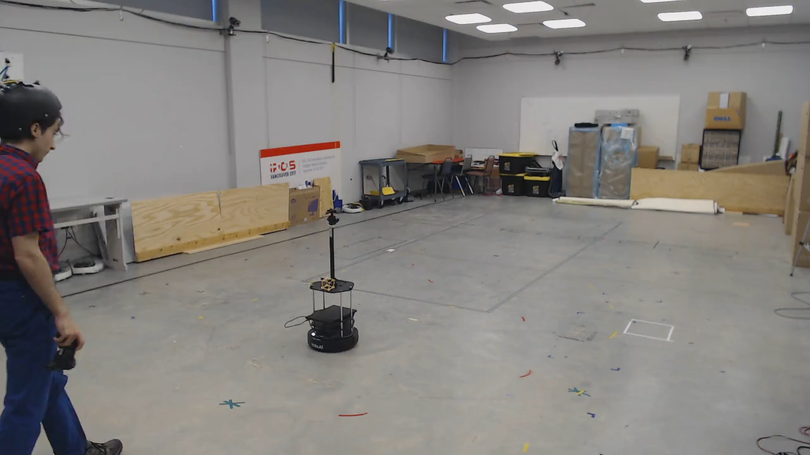
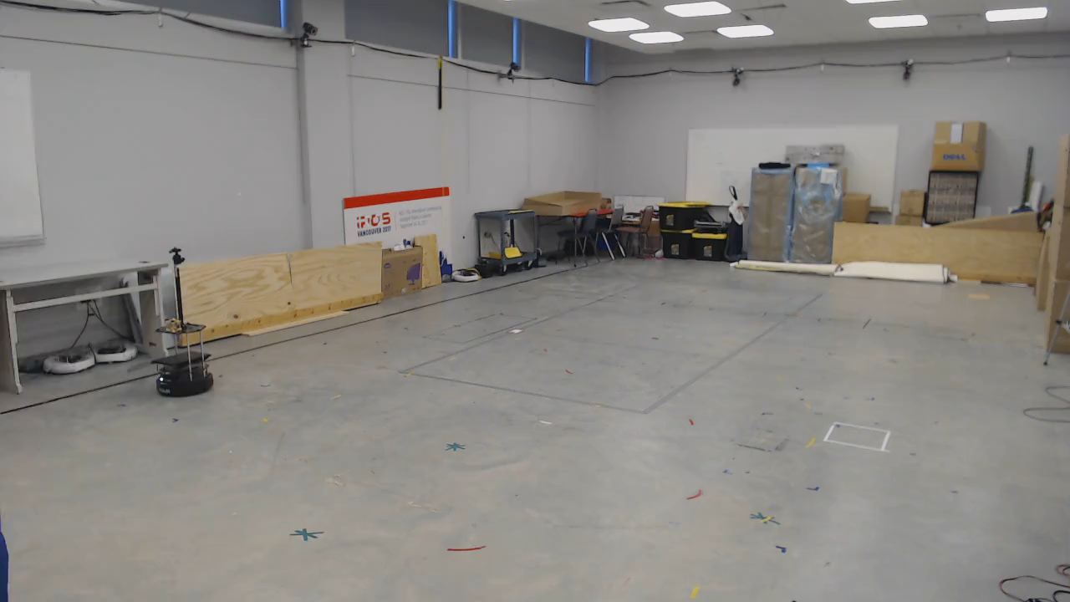
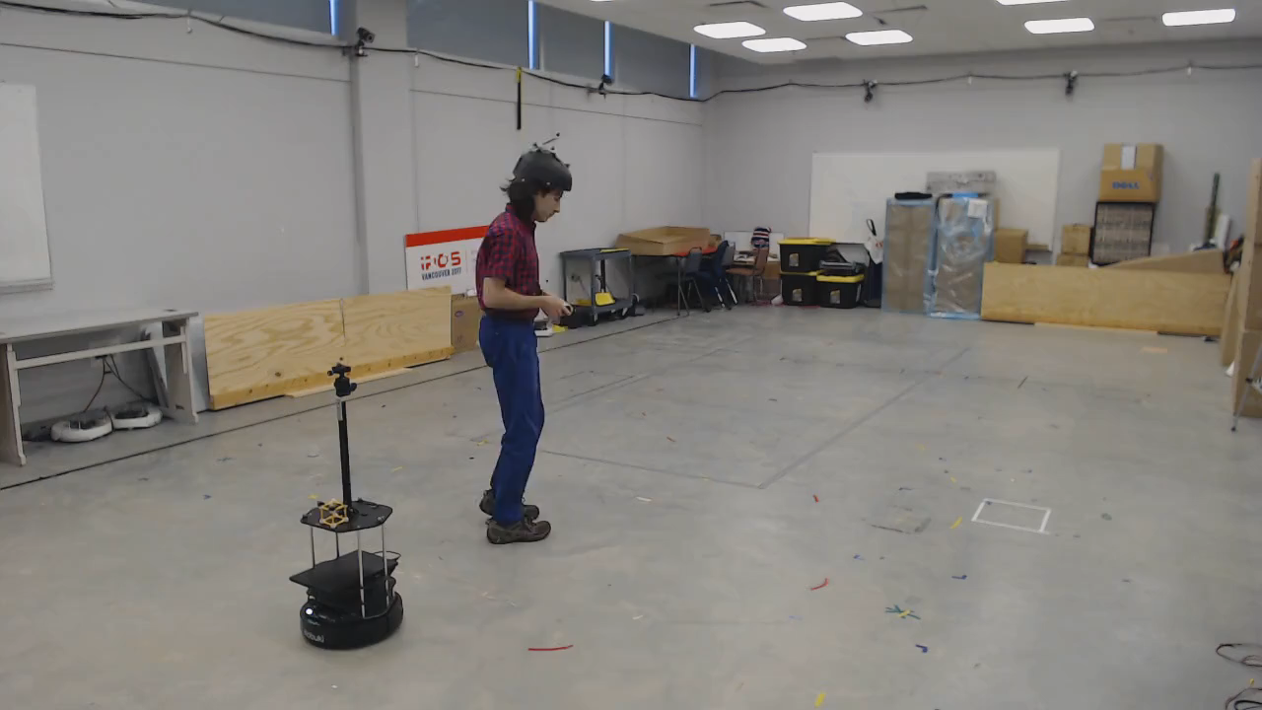
HC (Baseline)
Ahead-right
Ahead
Ahead-left
Behind

Slide 11
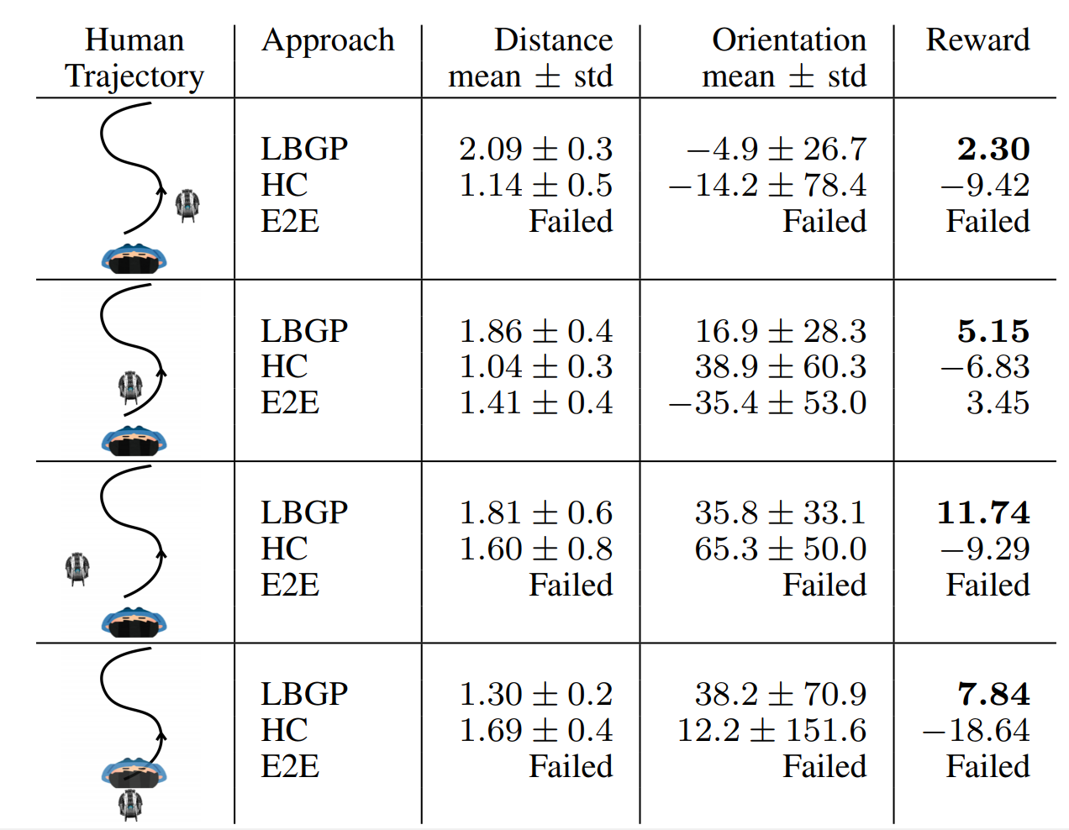
Real World Experiment S shaped Trajectory:
Notes:
This table shows the performance our method in compare to HC and E2E baselines for the S shaped experiment in 4 different initial settings.

Slide 12
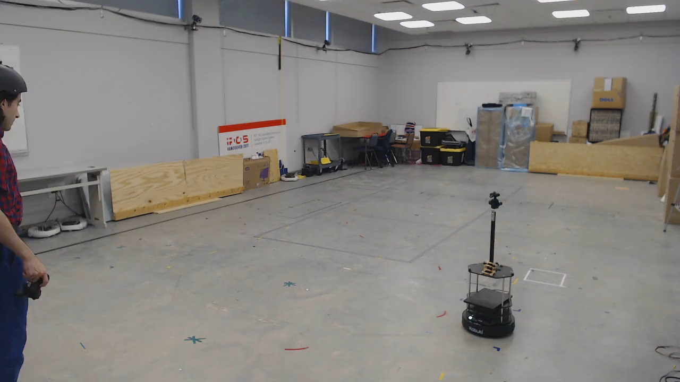
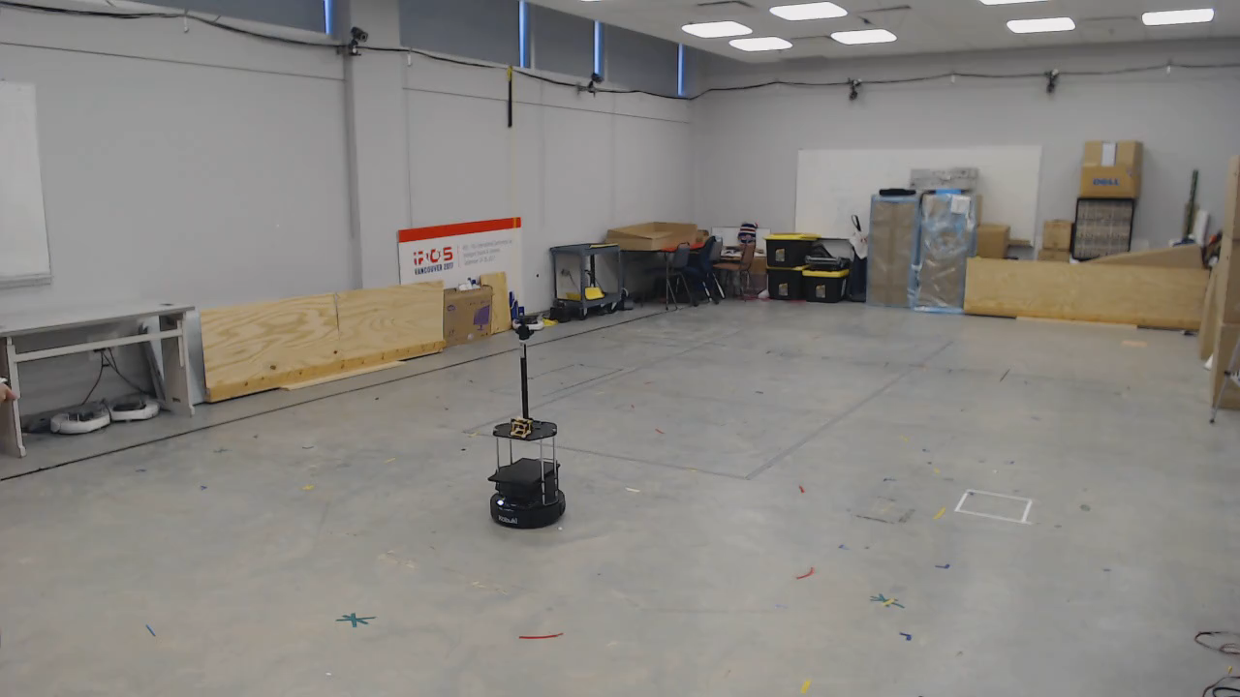
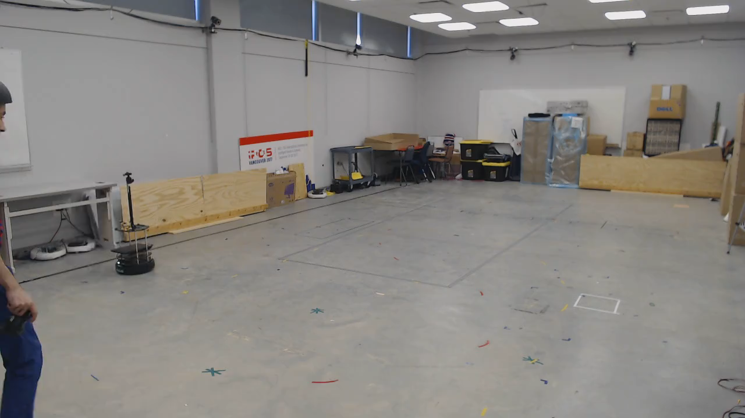
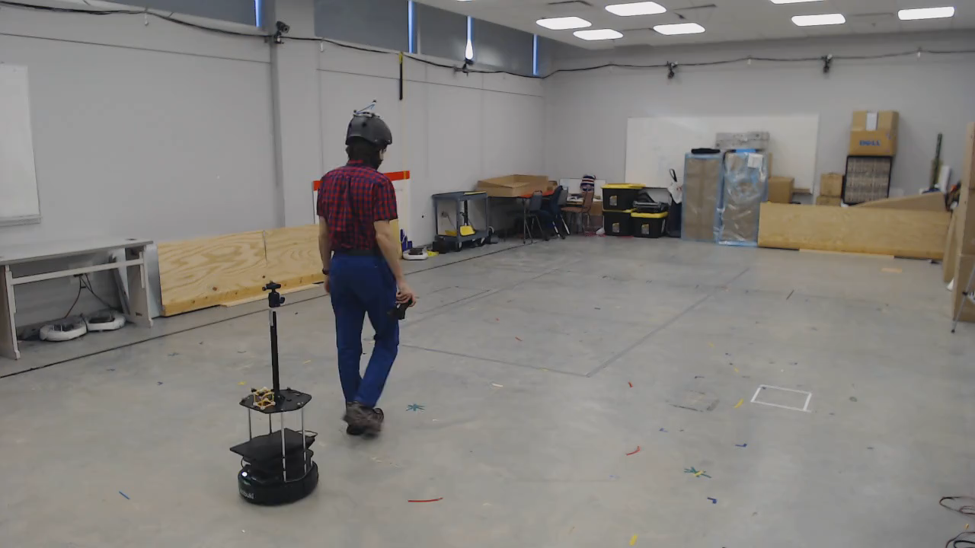
Our method (LBGP)
Ahead-right
Ahead
Ahead-left
Behind

Slide 13
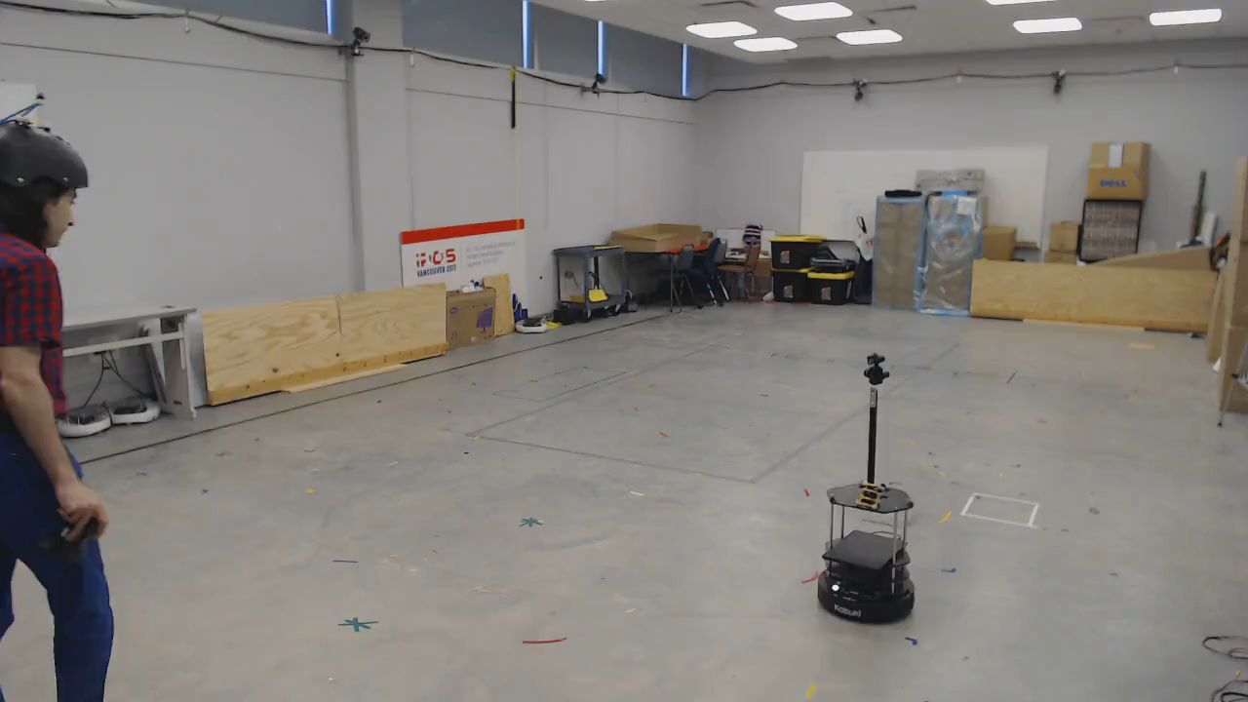
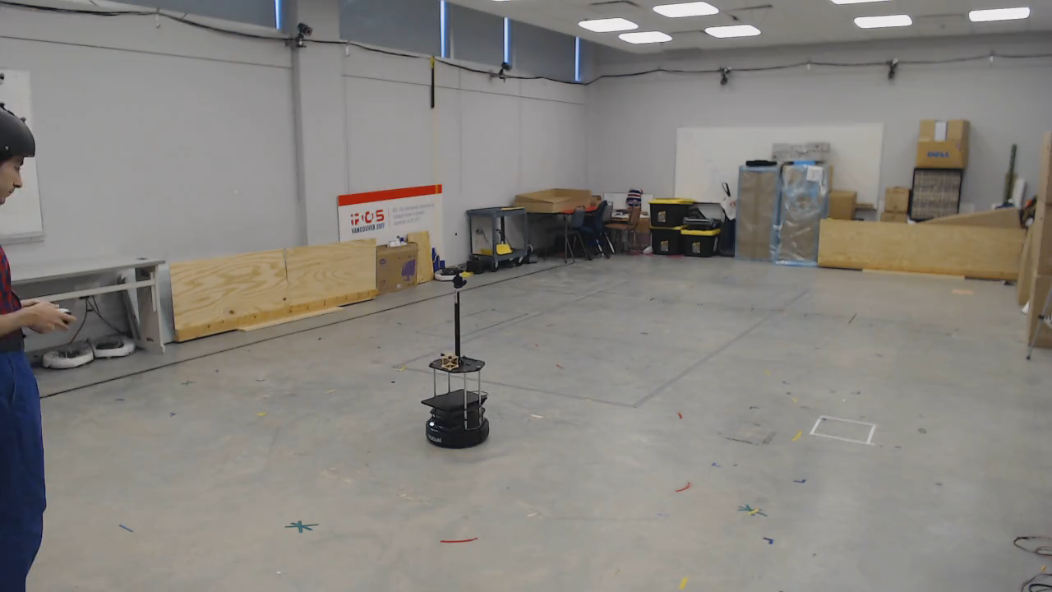
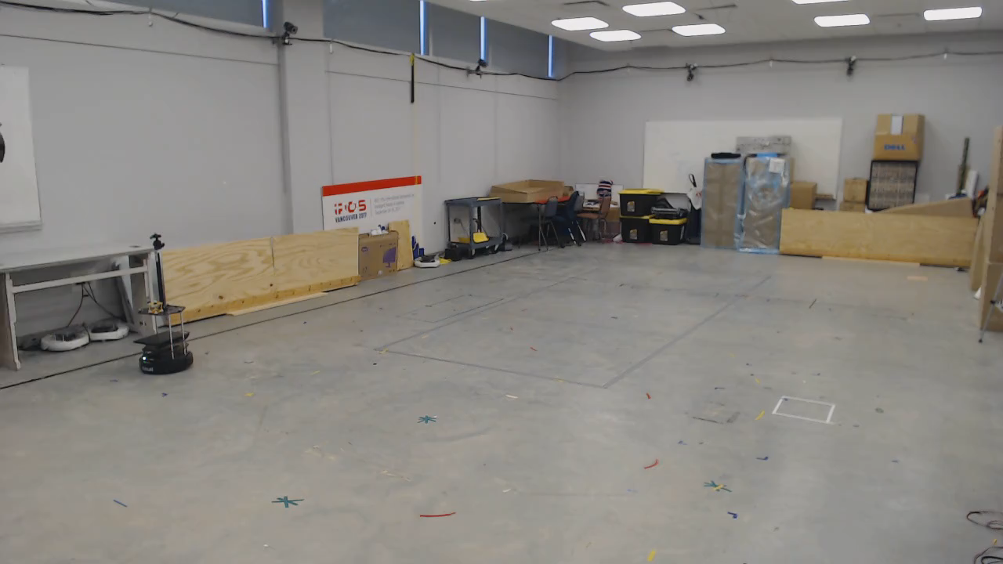
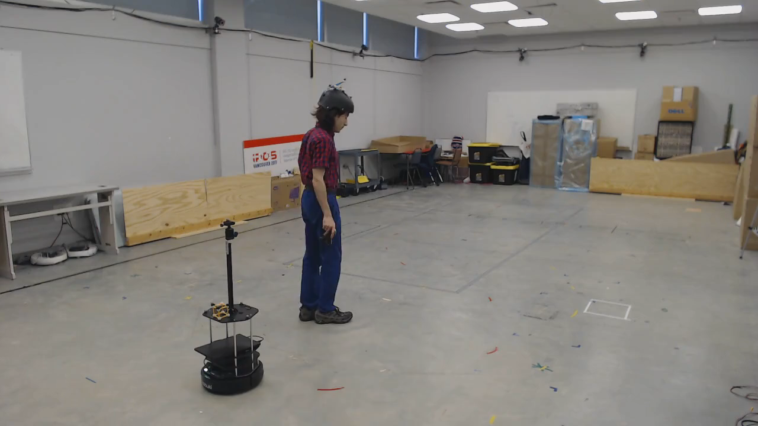
HC (Baseline)
Ahead-right
Ahead
Ahead-left
Behind

Slide 14
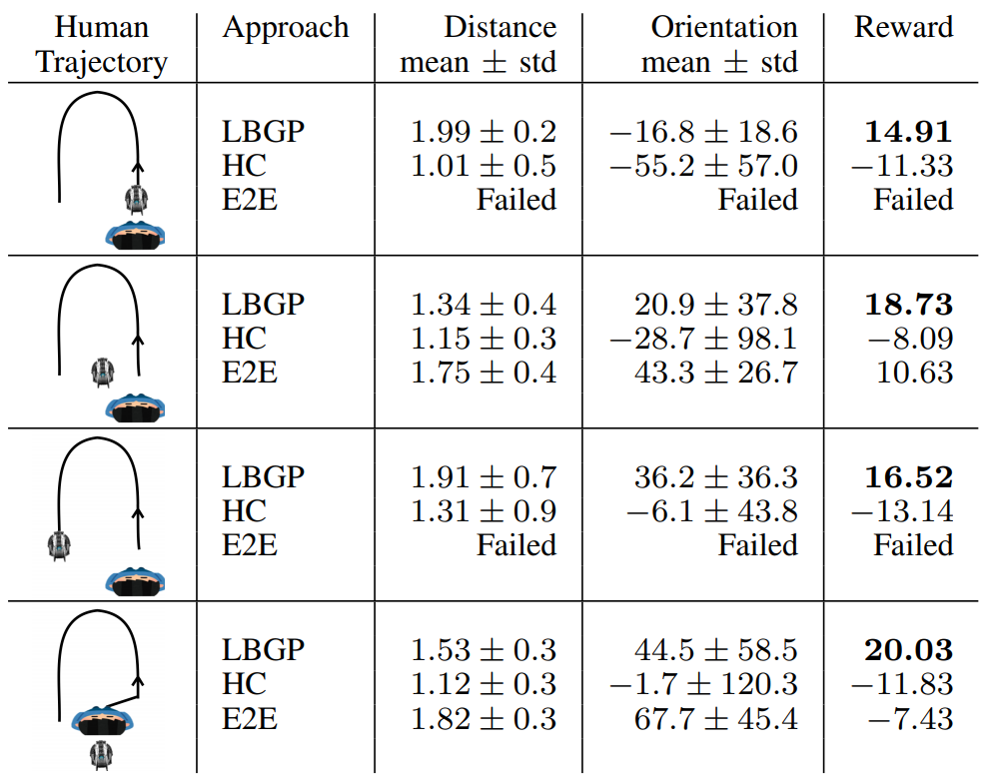
Real World Experiment U-Turn Trajectory:
Notes:
This table shows the of performance our method in compare to HC and E2E baselines for the U-Turn experiment in 4 different initial settings.

Slide 15
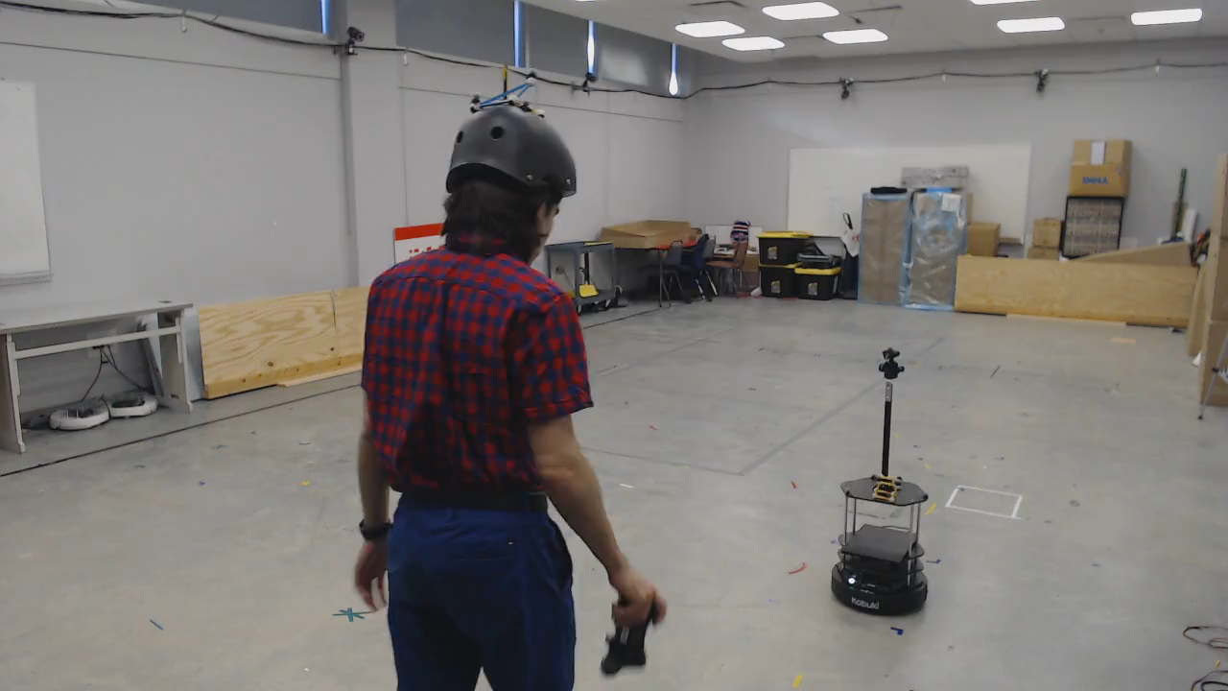
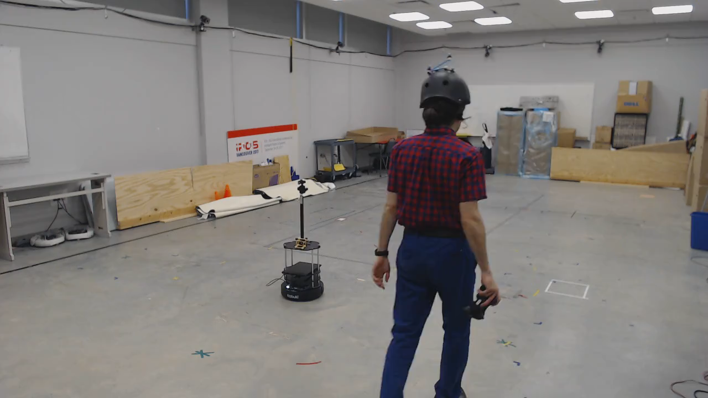
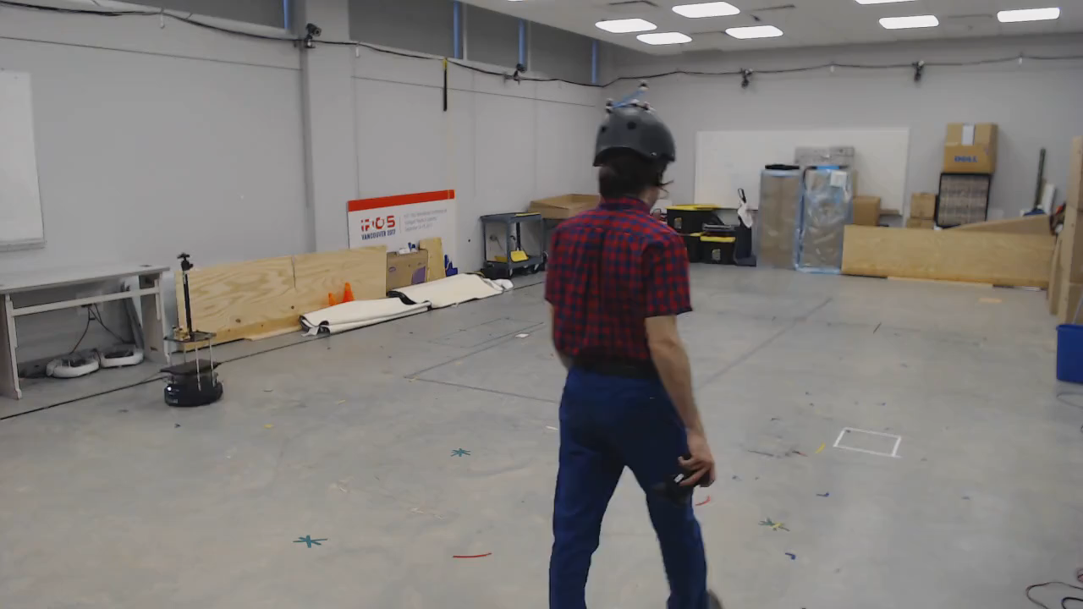
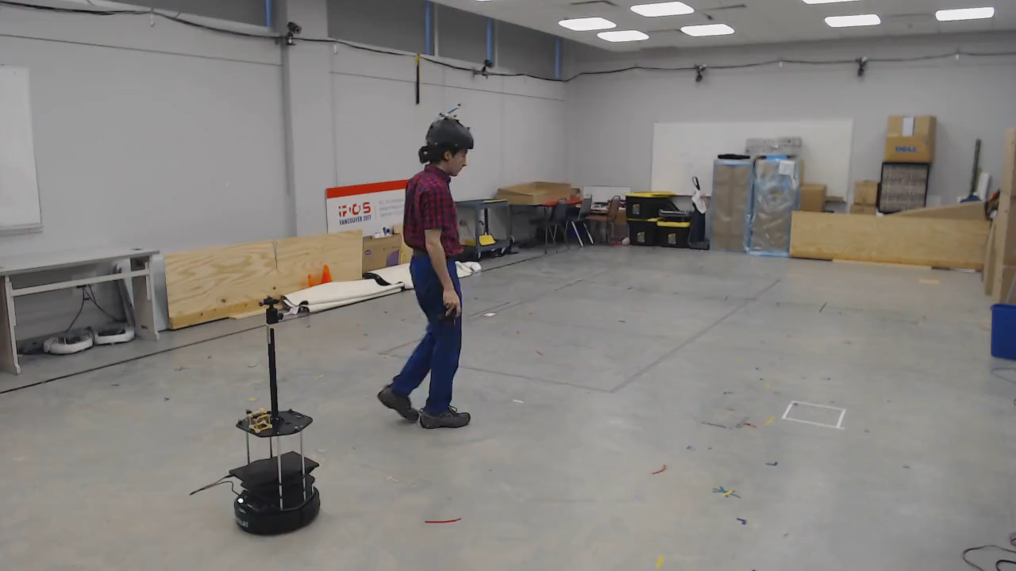
Our method (LBGP)
Ahead
Ahead-left
Ahead-far-left
Behind

Slide 16
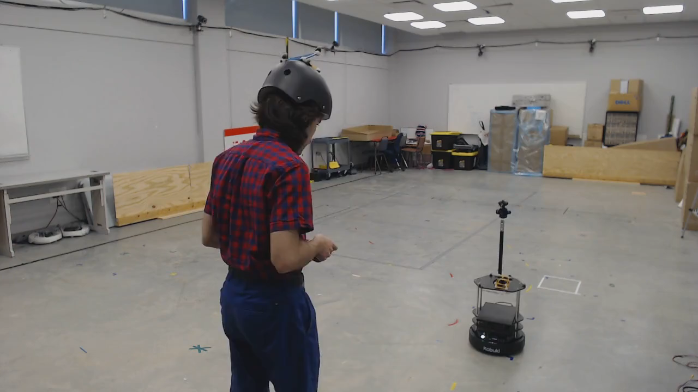
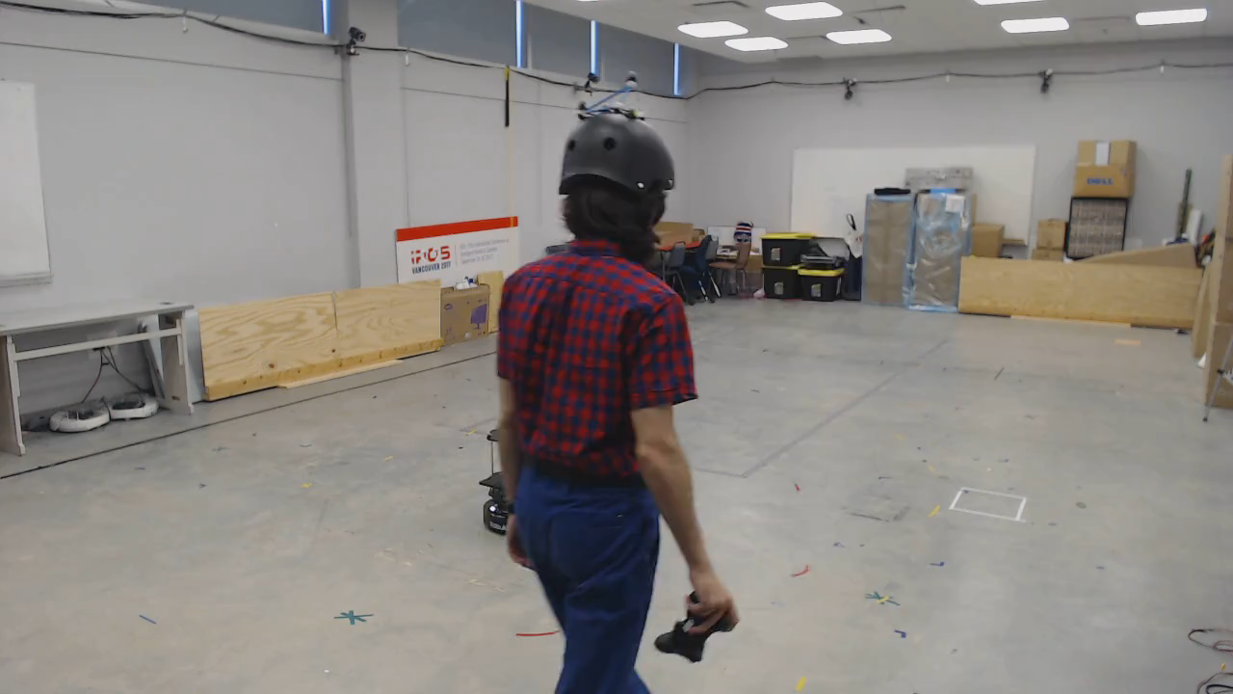
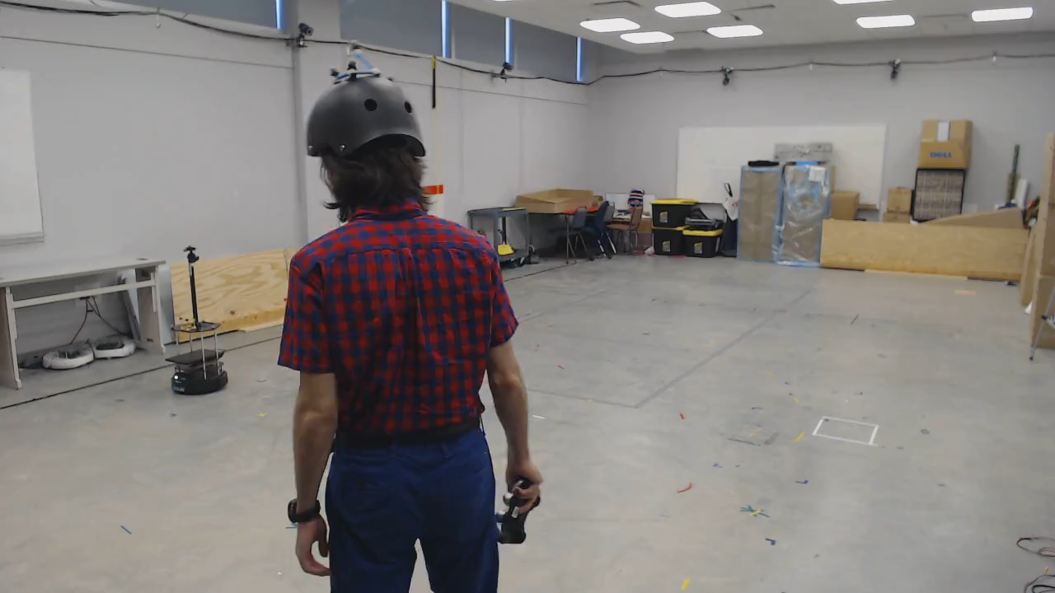
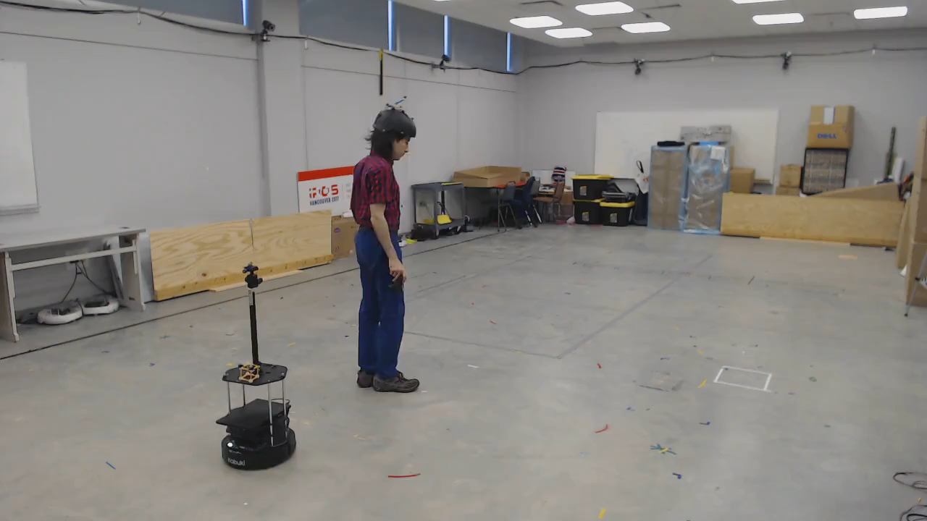
HC (Baseline)
Ahead
Ahead-left
Ahead-far-left
Behind

Slide 17

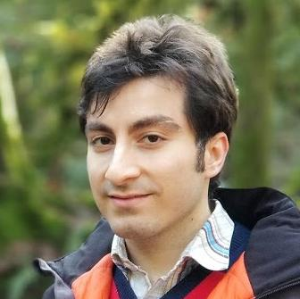
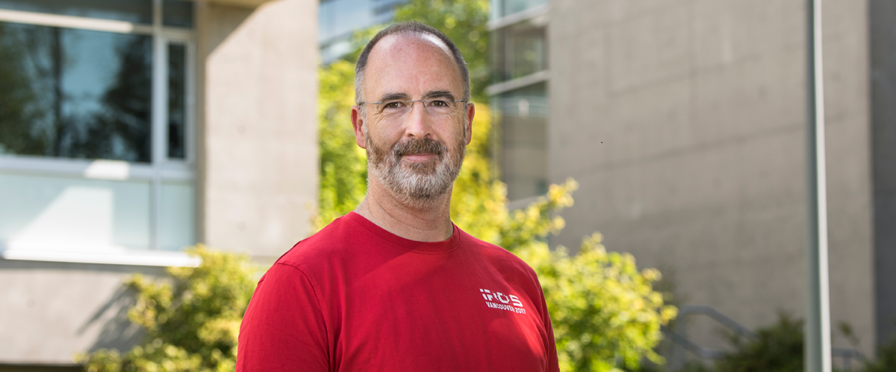
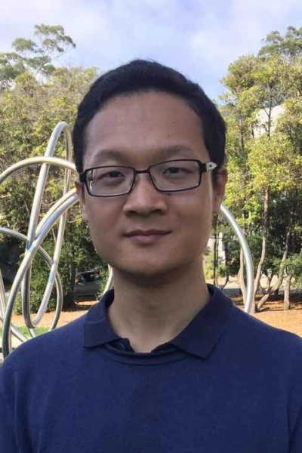


Payam Nikdel
PhD student
Richard Vaughan
Professor
Mo Chen Assistant Professor

